Slide 1
Solving Absolute Value Equations
AII.4a – The student will solve, algebraically and graphically, absolute value equations and inequalities. Graphing calculators will be used for solving and for confirming the algebraic solution.

Slide 2
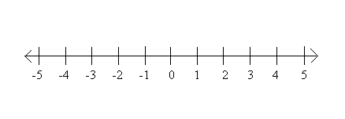
Absolute Value
Definition – The absolute value of a number is the DISTANCE between that number and zero on the number line.
What do you know about distance? (Think about the odometer in a car…)
It is always POSITIVE.
Ex: |3| =
3
|-5| =
5

Slide 3
Absolute Value Equations
If |x| = 3, what do you know about x?
Remember: Absolute Value is a distance.
x has a distance of 3 from zero.
If x is 3 ‘steps’ from zero on the number line, what could the value of x be?
x = 3 or
Thus the solution set for |x| = 3 {x | x = ±3}.
x = -3

Slide 4
Absolute Value Equations
If |a + 1| = 8, what do you know about a + 1?
a + 1 is 8 steps from zero.
If a + 1 is 8 steps from zero, what could the value of a + 1 be?
a + 1 = ±8
a + 1 = 8 or a + 1 = ⁻8
Solve these two equations…
Thus a =
Be sure to always check your solutions!
So if |a + 1| = 8 then {a | a = 7, -9}
Check: |a + 1| = 8
|7 + 1| = 8 |-9 + 1| = 8
|8| = 8 |-8| = 8
8 = 8 8 = 8
7 or a = -9

Slide 5
Absolute Value Equations
If |g - 3| = 10, what do you know about g - 3?
g - 3 is 10 steps from zero. What could the value of g – 3 be?
g - 3 = ±10
Thus g - 3 = 10 or g - 3 = -10
Solve these two equations and we get …
g = 13 or g = -7
Be sure to always check your solutions!
{g | g = 13, -7}
Check: |g – 3| = 10
|13 – 3| = 10 |-7 - 3| = 10
|10| = 10 |-10| = 10
10 = 10 10 = 10

Slide 6
Absolute Value Equations
If |5n| = -3, what do you know about 5n?
5n is -3 steps from zero. What could the value of 5n be?
Wait, can you be -3 steps from zero? Can distance ever be negative? NO!!
Thus this problem has no solutions!
We can write the solution as Ø or { }. It is called the null or empty set.

Slide 7
Absolute Value Equations
What do you notice is different about absolute value equations when compared to other equations you have solved?
Notes:
Teachers - big difference – TWO solutions!!!

Slide 8
Absolute Value Equations
What is new or different about the following equations?
2|x + 6| = 18 |4s – 8| - 7 = 3
Can you find the needed distance?
No – there are extra values in the problems. What can we do?
Use addition/subtraction/multiplication/ division to get the AV expression alone on one side. NOTE – you NEVER change what is between the AV bars!!!

Slide 9
Absolute Value Equations
2|x + 6| = 18
|x + 6| = 9
x + 6 = 9 or x + 6 = -9
x = 3, -15
Be sure to always check your solutions!
{x | x = 3, -15}
Divide both sides of the equation by 2
Check: 2|x + 6| = 18
2|3 + 6| = 18 2|-15 + 6| = 18
2|9| = 18 2|-9| = 18
2(9) = 18 2(9) = 18
18 = 18 18 = 18
Distance: x + 6 is 9 steps from 0
Solve

Slide 10
Absolute Value Equations
|4s – 8| - 7 = 3
|4s – 8| = 10
4s – 8 = 10 or 4s – 8 = -10
4s = 18 or 4s = -2
s = ⁹/₂, ⁻¹/₂
Be sure to always check your solutions!
{s | s = ⁹/₂, ⁻¹/₂}
Add 7 to both sides of the equation
Check: |4s – 8| - 7 = 3
|4(⁹/₂) – 8| - 7 = 3 |4(⁻¹/₂) – 8| - 7 = 3
|4(⁹/₂) – 8| = 10 |4(⁻¹/₂) – 8| = 10
|18 – 8|= 10 |-2 - 8| = 10
|10| = 10 |10| = 10
10 = 10 10 = 10
Distance: 4s – 8 is 10 steps from 0
Solve

Slide 11
Absolute Value Equations
|3d - 9| + 6 = 0
|3d - 9| = -6
d = { } or d = Ø
Remember, you can walk 6 steps forward, or you can walk 6 steps backwards, but you cannot walk -6 steps. Distance is always positive and is separate from the direction you are walking.
Subtract 6 from both sides of the equation
Distance: 3d - 9 is
-6 steps from 0.

Slide 12
Absolute Value Equations
What if we kept solving?
|3d - 9| = -6
3d - 9 = -6 or 3d - 9 = 6
3d = 3 or 3d = 15
d = 1, 5
Check: |3d - 9| = -6
|3(1) – 9| = -6 |3(5) – 9| = -6
|-6| = -6 |6| = -6
6 = -6 6 = -6
We would still get no solution!
X
X

Slide 13
Absolute Value Recap
The absolute value of a number represents the distance a number/expression is from 0 on the number line.
You NEVER change the AV expression inside the bars.
You can only determine the distance when the AV expression is isolated.
Once the AV is isolated, you can use the distance to write two equations and solve.
The distance is always the same expression – just the positive and negative value of it.

Slide 14
Absolute Value Equations
If |2m – 3| = m + 4, what do you know about 2m – 3?
2m – 3 is m + 4 steps from zero. What could the value of 2m + 3 be?
2m – 3 = ±(m + 4)
2m – 3 = m + 4 or
→ if we distribute the negative in the 2nd equation,
2m – 3 = -m – 4
2m – 3 = -(m + 4)

Slide 15
Absolute Value Equations
Solve |2m – 3| = m + 4
2m – 3 = m + 4 2m – 3 = -m – 4
m = 7 3m = -1
m = 7, -¹/₃
Be sure to always check your solutions
{m | m = 7, -¹/₃}
Check: |2m – 3| = m + 4
|2(7) – 3| = (7) + 4 |2(-¹/₃) – 3| = (-¹/₃) + 4
|14 – 3| = 11 |⁻²/₃ – 3| = ¹¹/₃
|11| = 11 |⁻¹¹/₃| = ¹¹/₃
11 = 11 ¹¹/₃ = ¹¹/₃

Slide 16
Absolute Value Equations
|8 + 5a| = 14 - a
8 + 5a = ±(14 – a)
8 + 5a = 14 – a or 8 + 5a = -(14 + a)
8 + 5a = 14 – a or 8 + 5a = -14 + a
a = 1, -5.5 (or ⁻¹¹/₂)
Be sure to always check your solutions!
{a | a = 1,⁻¹¹/₂}
Distance: 8 + 5a is 14 - a steps from 0
Check: |8 + 5a| = 14 - a
|8 + 5(1)| = 14 - 1 |8 + 5(-5.5)| = 14 - (-5.5)
|13| = 13 |-19.5| = 19.5
13 = 13 19.5 = 19.5
Solve

Slide 17
Absolute Value Equations
2|x| + 4 = 6x – 8
2|x| = 6x – 12
|x| = 3x – 6
x = ±(3x – 6)
x = 3x – 6 or x = -3x + 6
x = 3, ³/₂ (or 1.5)
Be sure to always check your solutions!
Isolate |x|: subtract 4 and divide by 2 (does this order matter?)
Check: 2|x| + 4 = 6x – 8
2|3| + 4 = 6(3) – 8 2| ³/₂ | + 4 = 6(³/₂) – 8
2(3) + 4 = 18 – 8 3 + 4 = 9 – 1
10 = 10 7 = 1
Distance: x is 3x - 6 steps from 0
X
Solve
X

Slide 18
Absolute Value Equations
Wait, ³/₂ did not work!! Since ³/₂ does not solve 2|x| + 4 = 6x – 8, we must throw it out of the solution set.
x = ³/₂ is called an extraneous solution. We did all the steps correctly when we solved the given equation, but all the solutions we found did not work. This is why you must check all solutions every time.
Thus, if 2|x| + 4 = 6x – 8, then {x | x = 3}.

Slide 19
Absolute Value Equations
|3x – 1| = 1 + 3x
3x – 1 = 1 + 3x or 3x – 1 = -1 – 3x
0 = 2 or 6x = 0
Ø or x = 0
Be sure to always check your solutions!
Check: |3x – 1| = 1 + 3x
|3(0) – 1| = 1 + 3(0)
|-1| = 1
1 = 1
{x | x = 0}
Distance: 3x – 1 is 1 + 3x steps from 0
Solve

Slide 20
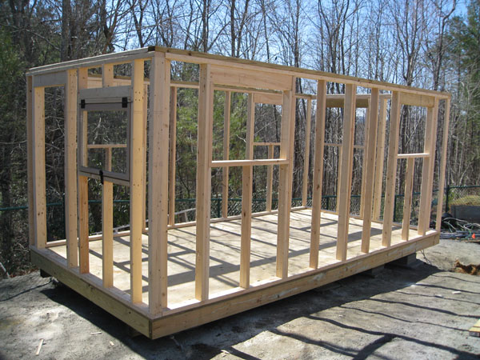
How far … and from where?
In carpentry, a stud is a vertical beam used to create support in a wall. Typically studs are positioned 2 feet apart. If there is a stud 8 feet from the intersecting wall, what are the positions of the studs on either side
6 ft. and 10 ft.
of the pictured stud (with respect to the intersecting wall)?
8 ft

Slide 21
How far … and from where?
How can create an equation that would give us this answer?
We are looking for a value based on how far apart two things are – the DISTANCE between them…
ABSOLUTE VALUE!!!!

Slide 22
How far … and from where?
Absolute value tells you the distance… what is the distance in this problem?
2
| | =
2
2 ft

Slide 23
How far … and from where?
What does the distance represent?
The ‘difference’ of the distances between the studs.
| | =
-
2
2 ft

Slide 24
How far … and from where?
What do we know about the studs?
One is at 8 feet from the intersecting wall. We don’t know the other.
| | =
x - 8
-
2
2 ft

Slide 25
How far … and from where?
Solve ….
x – 8 = ±2
x – 8 = 2 or x – 8 = -2
x = 10 or x = 6
x = 6, 10
| | =
x - 8
2

Slide 26
How far … and from where?
We can generalize this to be:
|unknown – given value| = distance
Our solutions for x are the values 2 feet from 8.
| | =
x - 8
2
|x – 8| = 2

Slide 27
How far … and from where?
|unknown – given value| = distance
What if we focused on a stud 5 feet from the intersecting wall? What would be the positions of the studs beside it?
3 feet and 7 feet
Create an absolute value equation that would allow us to solve for these values.
|x - 5| = 2
The solutions for x are the values 2 feet from 5.

Slide 28
How far … and from where?
Looking at our previous problems again…
The solution set for |g - 3| = 10 is
{g | g = 13, -7}.
Fill in the blanks …
The values of g are ____ steps from ____.
Let’s prove this with the graph.
10
3
10
3
10

Slide 29
How far … and from where?
The solution set for |a + 1| = 8 is
{a | a = 7, -9}.
The values of a are ____ steps from ____.
The solution set for |x + 6| = 9
(from 2|x + 6| = 18) is {x | x = 3, -15}.
The values of x are ____ steps from ____.
8
-1
8
-1
8
9
-6
9
9

Slide 30
How far … and from where?
And there is always the trouble maker…
The solution set for |4s – 8| = 10 was
{s | s = ⁹/₂, ⁻¹/₂}.
The values of s are ____ steps from ____ right?
NO!!! The two solutions are the same distance from what value?
2
10
8

Slide 31
How far … and from where?
The solution set for |4s – 8| = 10 was
{s | s = ⁹/₂, ⁻¹/₂}.
The values of s are ____ steps from ____.
How far are the solutions from 2?
2.5 steps
2.5
2
2.5
2.5

Slide 32
How far … and from where?
|unknown – given value| = distance
The solution set for |4s – 8| = 10 was
{s | s = ⁹/₂, ⁻¹/₂}.
The values of s are ____ steps from ____.
Why is this equation different?
In the other equations, there was not a coefficient with the unknown variable.
We need to keep the coefficient with the unknown value.
2.5
2

Slide 33
How far … and from where?
|unknown – given value| = distance
The solution set for |4s – 8| = 10 was
{s | s = ⁻¹/_{2,} ⁹/₂}.
The values of are ____ steps from ____.
The values that are 10 steps from 8 are -2 and 18.
So 4s = -2 and 4s = 18.
Thus s = -½ and s = ¹⁸/₄ = ⁹/₂
4s
10
8

Slide 34
How far … and from where?
|unknown – given value| = distance
What if our equation was |-3f - 6| = 21?
The values of are ___ steps from ___.
The values that are 21 steps from 6 are
So -3f = 27 and -3f = -15.
Thus f = -9 and f = 5
So the solution to |-3f - 6| = 21 is {f | f = -9, 5}
-3f
21
6
27 and -15.

Slide 35
How far … and from where?
Going back to our very first example |x| = 3,
the solutions are ____ steps from ____.
How does this fit into our generalized equation?
|unknown – given value| = distance
The given value is 0 but we don’t need to write the equation as |x – 0| = 3.
3
0

Slide 36
Examples
Use the generalized form of an absolute value equation to solve each problem.
|3m – 15| = 12
The values of 3m are ___ steps from ___.
3m = 27 and 3m = 3
m = 9 and m = 1
Thus the solution set for |3m – 15| = 12 is {m | m = 1, 9}.
12
15
15 ± 12 = ?

Slide 37
Examples
Use the generalized form of an absolute value equation to solve each problem.
Solve: 2|5h + 10| - 7 = 1
Can we tell the distance here?
No, we must isolate the absolute value.
|5h + 10| = 4
The values of 5h are ___ steps from ___.
-10 ± 4 = -6, -14
5h = -6 and 5h = -14
{h | h = -1.2, -2.8}
4
-10

Slide 38
Examples
You can still solve using straight Algebra.
2|5h + 10| - 7 = 1
|5h + 10| = 4
The distance is 4, so 5h + 10 = ±4
5h + 10 = 4 or 5h + 10 = -4
5h = -6 or 5h = -14
h = -6/5 or h = -14/5
h = -1.2 or h = -2.8
{h | h = -1.2, -2.8}

Slide 39
One more method… graphing!
Solve |2x - 3| = 5
{x | x = 4, -1}
Let’s explore how the graphing calculator can help us determine this solution.

Slide 40
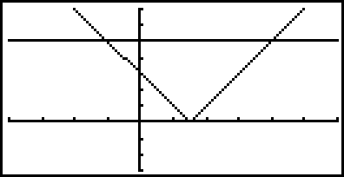
Solve by Graphing
Graph y = |2x - 3| and y = 5 using your graphing calculator. (See the next slides for directions.)
My window: x-min: -4, x-max: 6; y-min: -3, y-max 7; all scales = 1

Slide 41
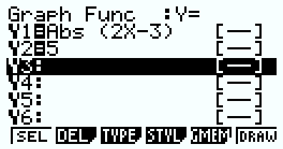
Graphing
Casio Directions
Main Menu – Select Graph (5)
Delete any equations already in the graph menu (DEL (F2), Yes (F1))
To find the absolute value function: hit the OPTN button. Choose NUM (F5) then Abs (F1).
To graph the functions hit DRAW (F6) or EXE.

Slide 42
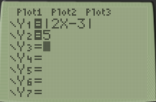
Graphing
TI Directions
Hit the y = button
Delete any equations already in the y = menu by putting the cursor on it and hitting CLEAR.
To find the absolute value function: hit the MATH button. Use your arrow buttons to highlight NUM then select #1: abs( .
Hit the GRAPH button to graph the functions.

Slide 43
Graphing
Based on our graph, what could be the solutions to: |2x - 3| = 5 ?
We want to know where the two graphs are equal, so we are looking for their intersection.
x = -1, 4

Slide 44
Graphing
Verify that {g | g = 13, -7} are solutions to |g - 3| = 10 by using the graph.
What are the two equations you need to graph?
y = |g - 3| and y = 10

